Slide 1
Succeeding as a Statistician in a Liberal Arts College
Nicholas Horton, nhorton@amherst.edu
April 23, 2019
Notes:
Helping the next generation of students to think with data: Statistics and Data Science at Amherst College
The proliferation of complex and rich data has been a boon for statistics and data science. The growing recognition of the role that statistical analysis plays in making evidence-based decisions has led to the development of the new major in statistics at Amherst College. In this talk, Nicholas Horton and a group of Amherst students will describe work to ensure that Amherst graduates across the curriculum have the capacity to extract meaning from data in the world around them.

Slide 3
Amherst College in a Nutshell
n=1800 students, 200 faculty
Talented and diverse students
45% of students are domestic students of color
20% Pell Grant eligible
11% first generation students
1 faculty member in probability or statistics in 2004
6 faculty members (5 tenure track plus one permanent lecturer) now
Thriving statistics major

Slide 5
Finding 2.3 A critical task in the education of future data scientists is to instill data acumen. Key concepts include:
Mathematical foundations Computational foundations Statistical foundations Data management and curation Data description and visualization Data modeling and assessment Workflow and reproducibility Communication and teamwork Domain-specific considerations Ethical problem solving.

Slide 6
Finding 2.3 A critical task in the education of future data scientists is to instill data acumen. Key concepts include:
Mathematical foundations Computational foundations Statistical foundations Data management and curation Data description and visualization Data modeling and assessment Workflow and reproducibility Communication and teamwork Domain-specific considerations Ethical problem solving.
Data science: a
liberal art with a
long history

Slide 7
X
180th

Slide 8
Learning from the past: founding members of the ASA
Notes:
Founding in 1839
Centenary 1939: paper
Anniversary 1964
1989: Mosteller
Top 10 papers

Slide 9
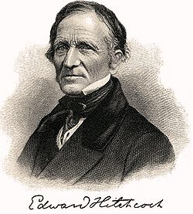
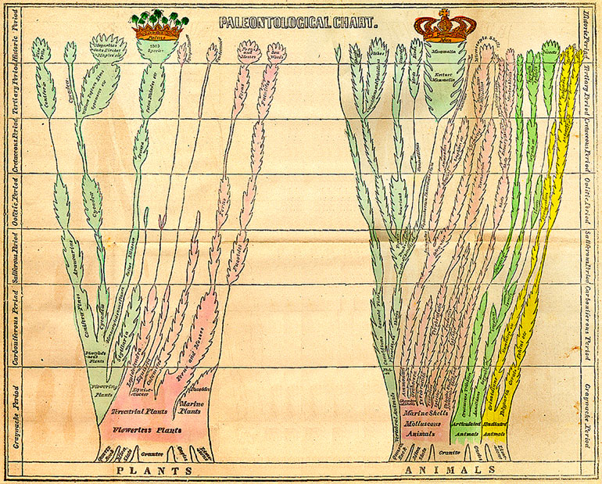
Amherst College’s Edward Hitchcock
Geology professor (who liked to count!)
Later became third President of Amherst College (1845-1854)
Notes:
Fold-out paleontological chart of Edward Hitchcock in Elementary Geology (1840) “Tree of Life”

Slide 10
STAT231 (Data Science) text analytics

Slide 11
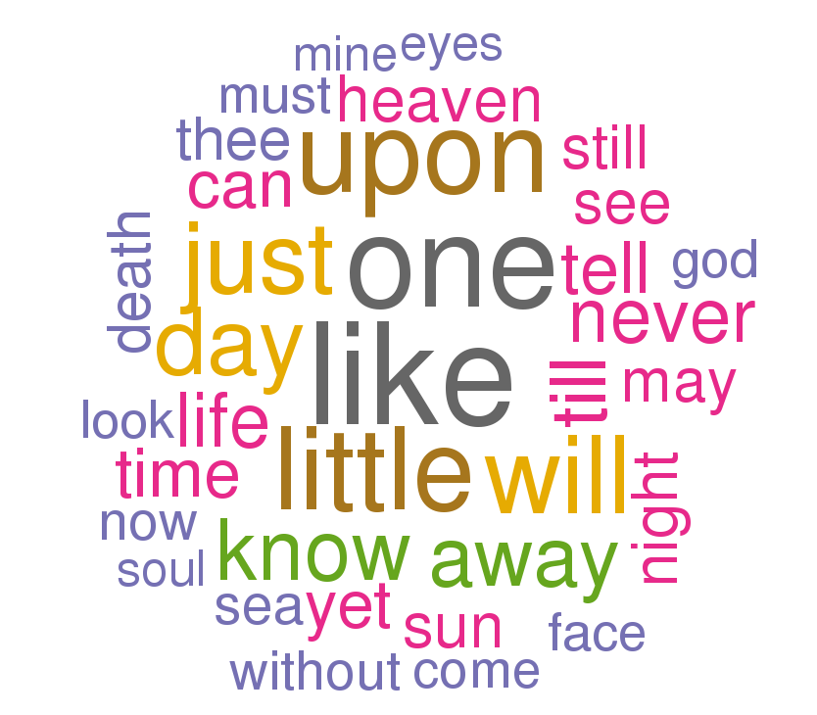
Emily Dickinson
https://r.amherst.edu/apps/nhorton/Dickinson1/
https://r.amherst.edu/apps/nhorton/shiny-dickinson/

Slide 15
What is happening at Amherst? Statistics major
First four statistics majors graduated in 2015, four in 2016, 10 in 2017, 21 in 2018, 21 in 2019
New capstone course (Advanced Data Analysis)
New 200-level Data Science course
Increased focus on data wrangling, ethics, and communication in all courses
Computing and workflow integrated into year-long probability/theoretical statistics sequence
Comprehensive project to assess completion of the learning outcomes of the major

Slide 16
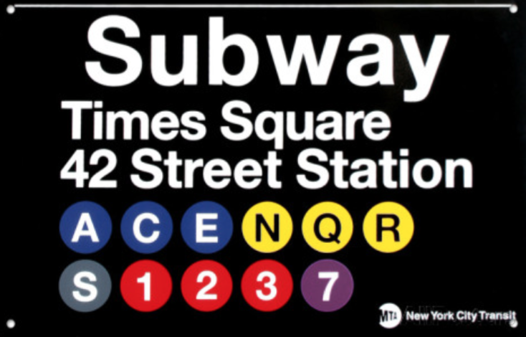

Slide 18
Curriculum (as of 2019)
Intro Stats with Modeling (STAT135)
Intermediate Statistics (STAT230)
Data Science (STAT231)
Probability (STAT360)
Theoretical Statistics (STAT370)
Advanced Data Analysis (STAT495)
Electives: Multivariate (STAT240), Statistical Communication (STAT320), Epidemiology and Causal Inference (STAT340), COSC 247 (Data Mining), COSC 255 (Databases)

Slide 19
Statistics and Data Science Fellows program
Instituted in 2013 to create a cohort of students that could address data challenges across the campus
Now expanded to ten students (rising sophomores, juniors, and seniors) with competitive selection process
Provide drop-in hours for intro stats and data wrangling questions
Organize the Festival of R and R Markdown each semester
Prepare and present workshops to lead up to DataFest
Conduct data-related projects across campus
All under the direction of the Statistics Faculty

Slide 20
Moss Quantitative Center module development
Pairing up faculty to develop quantitative modules for social science and humanities courses
Austin Sarat (LJST) “America’s Death Penalty” (COLQ234): logistic regression models to disentangle predictors of receiving a death penalty sentence
Kerry Ratigan (Government) “Politics of Protest” (POSC330): focus on survey methods, multiple regression, and data visualization
Amy Coddington (English) “Digital Humanities”

Slide 21
Data Fest: weekend-long data challenge

Slide 22
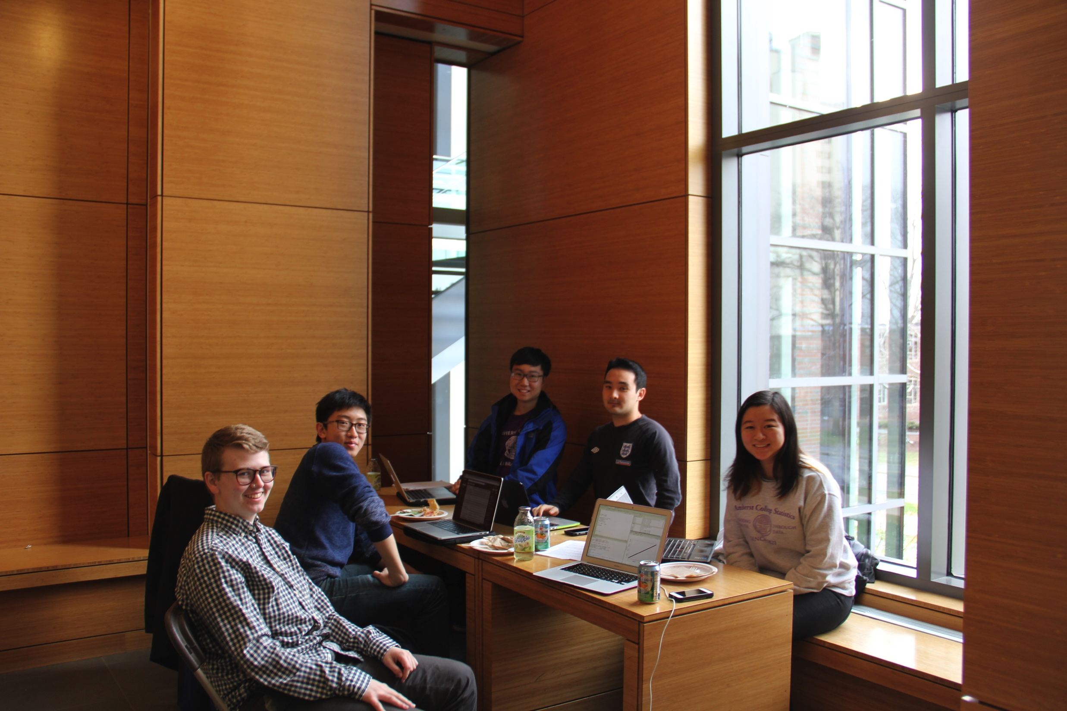
9. DataFest

Slide 24
9. DataFest

Slide 25
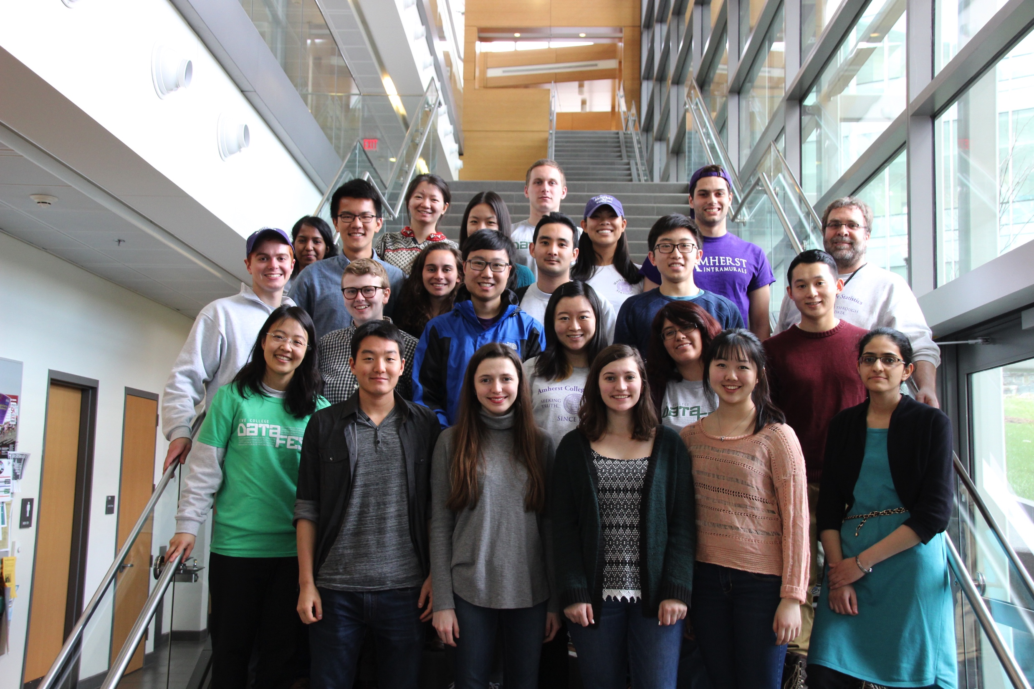

Slide 27
Notes:
Jingwen Zhang, Jerry Chen, Leonard Yoon, Jordan Browning, and Brendan Seto

Slide 28
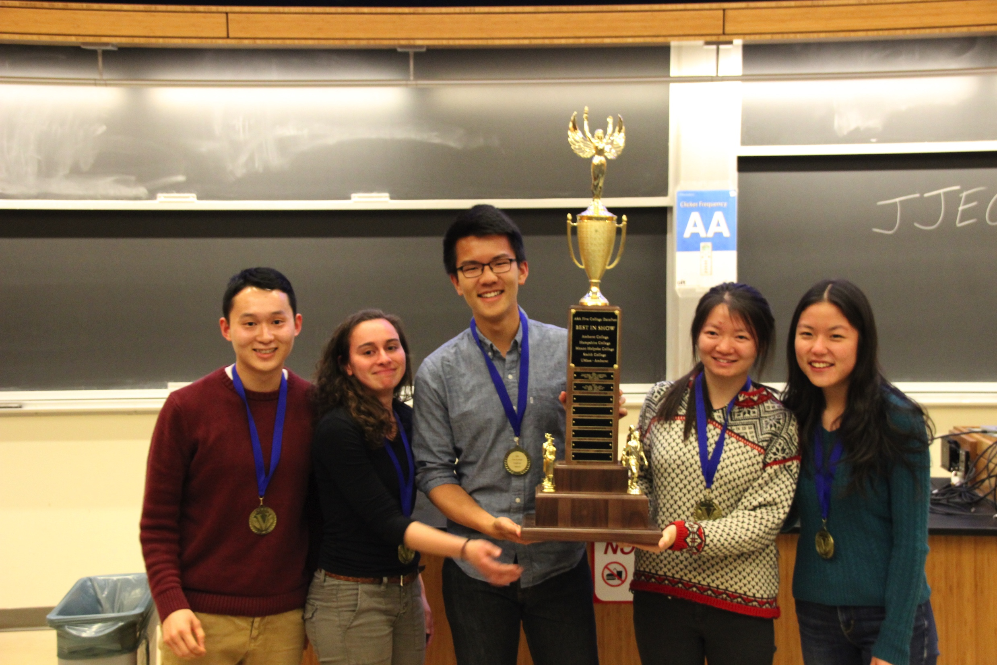
Notes:
Timothy Lee, Pei Gong, Shelly Tang, Jonathan Che, and Sarah Teichman win Best in Show

Slide 30
“Research” College Model
2-2 course load, 20-30 students per course, intensive engagement
Resources to support projects with students, conference travel, related research expenses
Many opportunities for collaboration on campus (and beyond)
Modern computation available (grid and cluster computing)
Regular sabbaticals (one semester every three years)
Research expectations (ongoing scholarly engagement)

Slide 31
Succeeding as a Statistician in a Liberal Arts College
Questions?
Nicholas Horton, nhorton@amherst.edu

